Slide 1

Predicting stock returns using CAPM and FAMA French

Slide 2

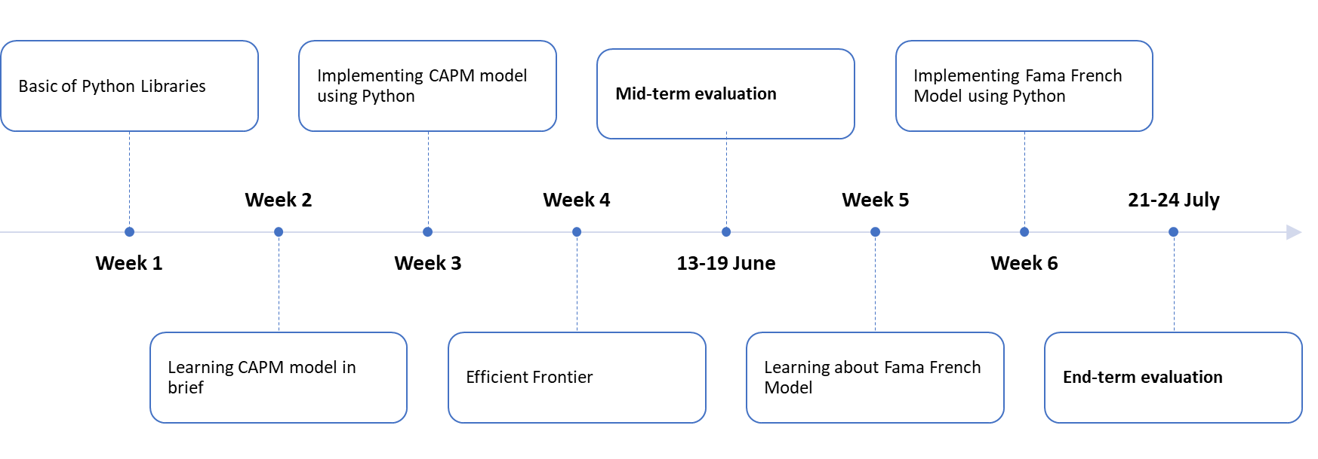
What we have learnt.......

Slide 3


Week 1:
Pyhton Libraries
In week 1 we learned about some python libraries which were Matplotlib, Scipy, Pandas, pandas_datareader and datetime.

Slide 4


Week 2:
CAPM Model
Our objective was to learn-
Getting Started with the CAPM model.
> What is the CAPM model?
> What is Security Market Line? (SML) Basics Statistics (Linear Regression, R-squared, P-Value)
What is Excess Return? (Terminologies like Sharpe Ratio, alpha and beta) Efficient Frontier

Slide 5
Capital Asset Pricing Model
In finance, the capital asset pricing model (CAPM) is a model used to determine a theoretically appropriate required rate of return of an asset, to make decisions about adding assets to a well-diversified portfolio.
The model takes into account the asset's sensitivity to non-diversifiable risk (also known as systematic risk or market risk), often represented by the quantity beta (β) in the financial industry, as well as the expected return of the market and the expected return of a theoretical risk-free asset.

Slide 6
Security Market Line
The security market line (SML) is a line drawn on a chart that serves as a graphical representation of the capital asset pricing model (CAPM)—which shows different levels of systematic, or market risk, of various marketable securities, plotted against the expected return of the entire market at any given time.1
Also known as the "characteristic line," the SML is a visualization of the CAPM, where the x-axis of the chart represents risk (in terms of beta), and the y-axis of the chart represents expected return. The market risk premium of a given security is determined by where it is plotted on the chart relative to the SML.

Slide 7
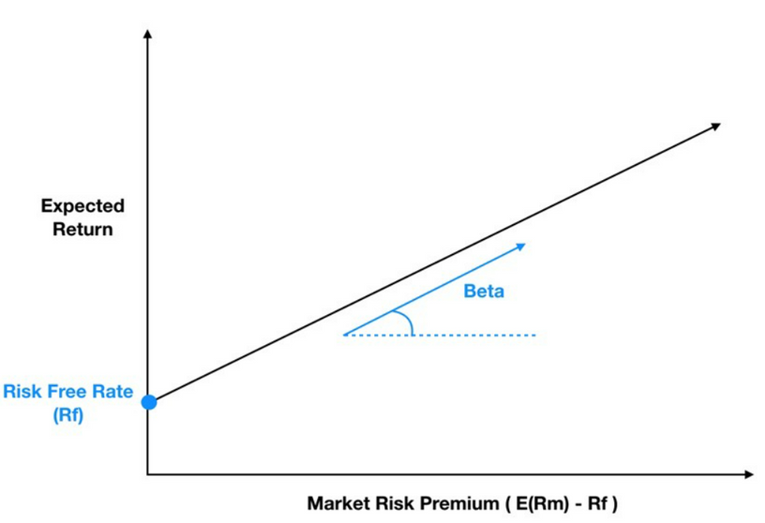
Linear Regression :
Regression is a statistical method used in finance, investing, and other disciplines that attempts to determine the strength and character of the relationship between one dependent variable (usually denoted by Y) and a series of other variables (known as independent variables.

Slide 8
Sharpe Ratio
Sharpe ratio is the measure of risk-adjusted return of a financial portfolio. A portfolio with a higher Sharpe ratio is considered superior relative to its peers.
Ratio: ​(Rp​−Rf)/σp
where:Rp​=return of portfolio
Rf​=risk-free rate
σp​=standard deviation of the portfolio’s excess return

Slide 9


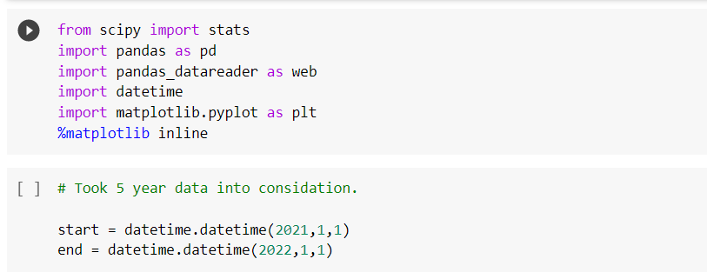
Week 3:
Implementing CAPM Model using Python

Slide 10
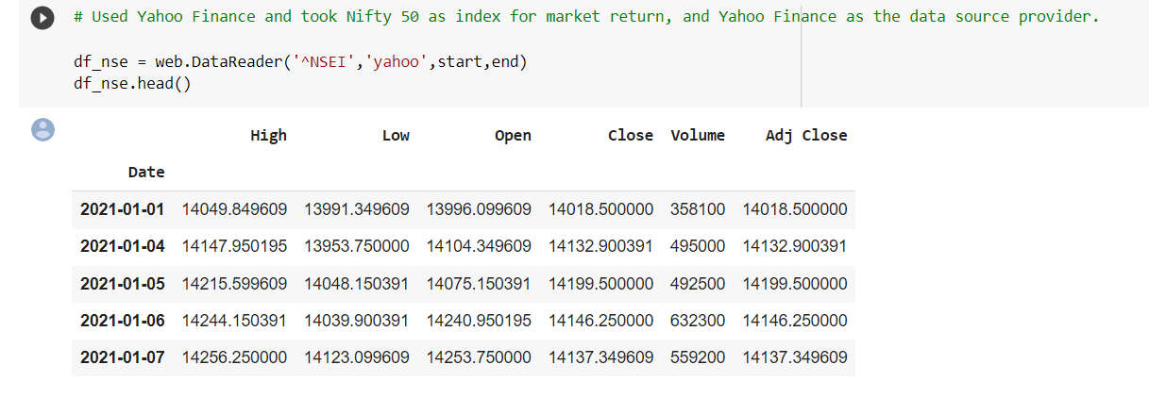
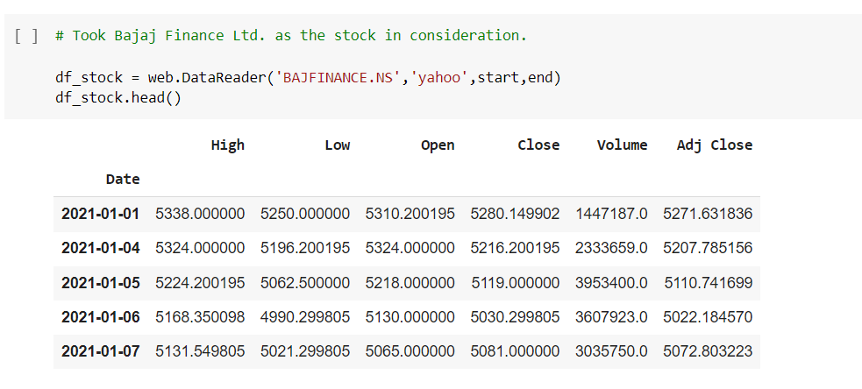

Importing Data from Yahoo

Slide 11
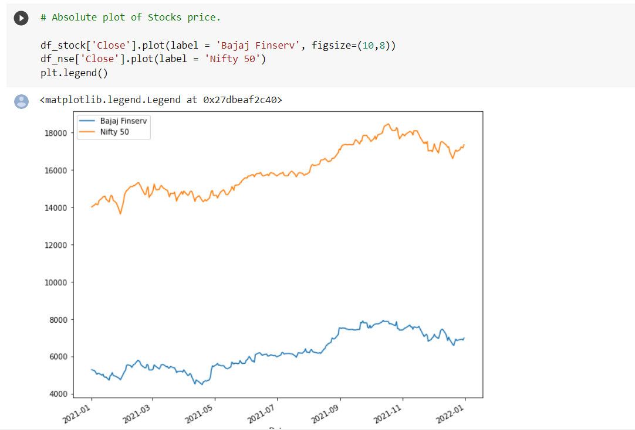
Plotting Closing Values Curve for both Stocks

Slide 12
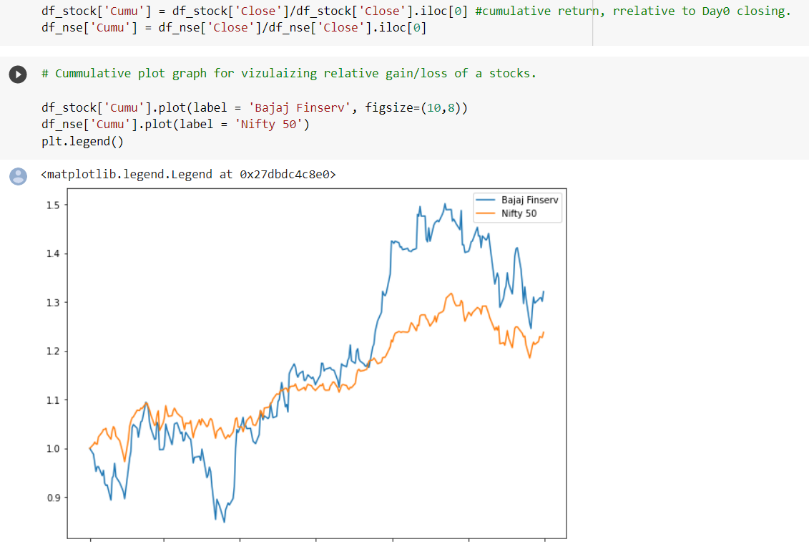
Adjusting Values of Close and Plotting Curve of Adjusted Values

Slide 13
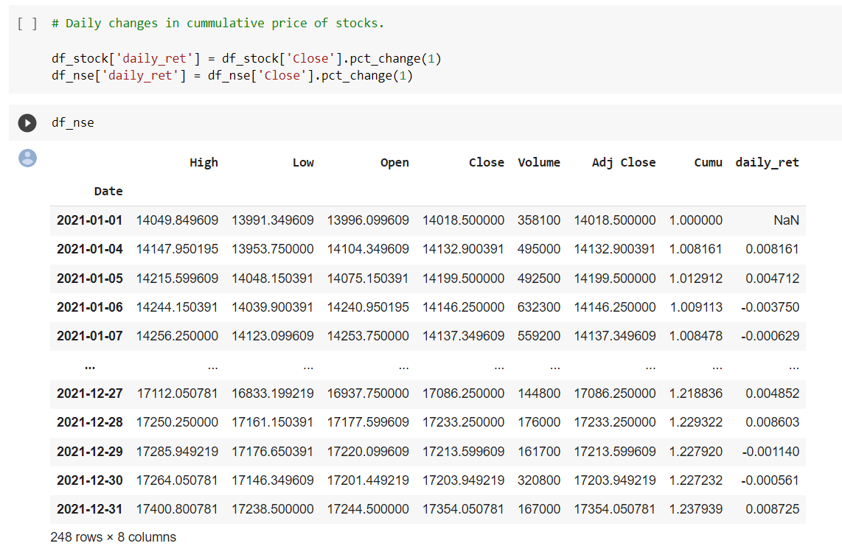
Introducing a new Column for Daily Return

Slide 14
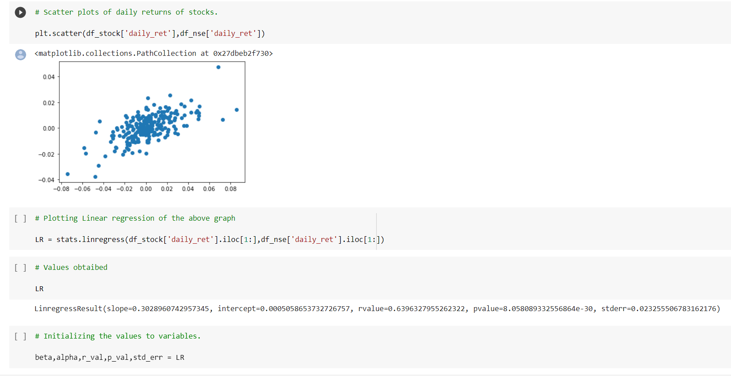
Plotting Scatter plot for Daily Returns and
Using linear regression to find Alpha and Beta

Slide 15
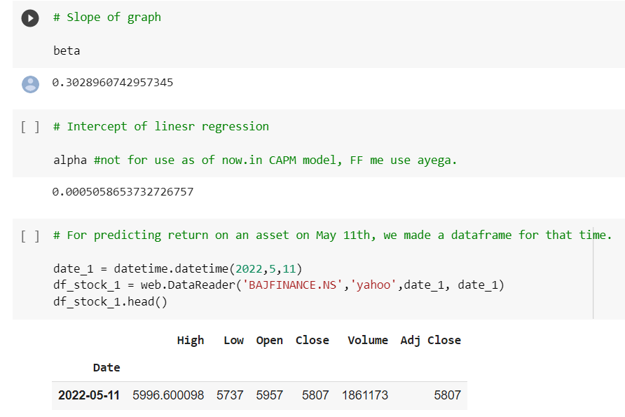
Uploading data of a particular date to compare return Values

Slide 16
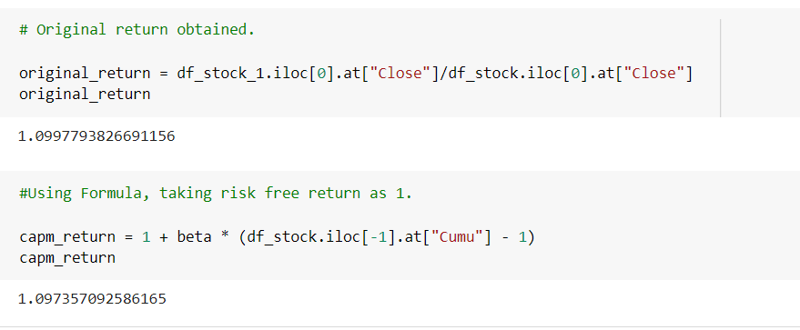
Comparing Original and CAPM return

Slide 17
Week 4
Efficient Frontier
OUR TASK WAS TO REPLICATE THE EFFICIENT FRONTIER GRAPH IN EXCEL

Slide 18
WHAT IS THE EFFICIENT FRONTIER?
The efficient frontier is the set of optimal portfolios that offer the highest expected return for a defined level of risk or the lowest risk for a given level of expected return. Portfolios that lie below the efficient frontier are sub-optimal because they do not provide enough return for the level of risk

Slide 19
EFFICIENT FRONTIER
¨WE WERE PROVIDED WITH DATA OF TWO STOCKS: STOCK A & STOCK B. FIRSTLY, WE NEED TO PLOT THE ADJUSTED CLOSE DATA FOR THE TWO STOCK.THEN, IN THE 'MODEL' PAGE, CALCULATE THE MEAN, STDEV, VARIANCE, SHARPE RATIO, COVARIENCE, AND CO-RELATION OF THE TWO STOCK. (REMEMBER, THAT THE PRICE OF BOTH THE STOCK IS DIFFERENT, SO WE MUST TAKE ADJUSTED VALUE IN CALCULATION OF ALL THIS DATA.)THEN, VARY THE SHARE OF STOCK A FROM 0,1..100 IN THE PORTFOLIO. (SHARE OF STOCK B = 100- STOCK A)THEN, FROM THE VALUES CALCULATED, PLOT THE GRAPH OF MEAN V/S STDEV.FROM THIS GRAPH, CALCULATE THE VALUE OF MAXIMUM SHARPE RATIO. (MIN RISK MAX RETURN)

Slide 20

Mean of particular Portfolio
= (percentage of stock A*Mean return of stock A )+ (percentage of stock B*Mean return of stock B)

Slide 21
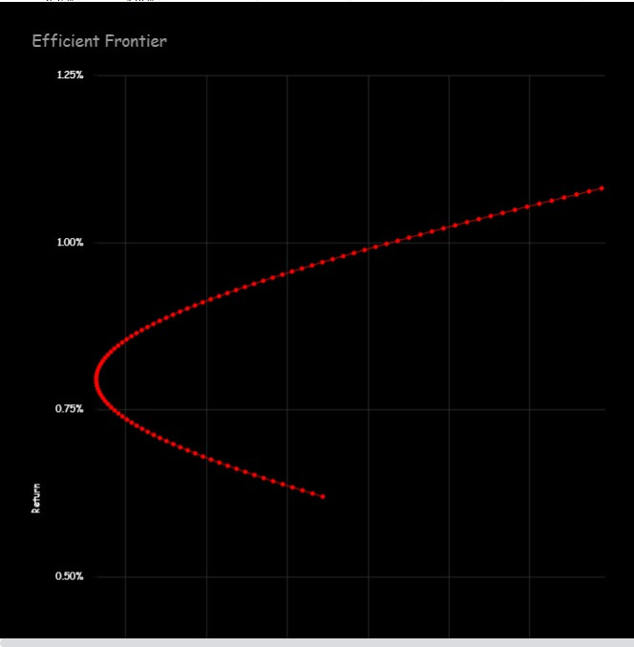
A
l
l
l
l
l
l
B

Slide 22
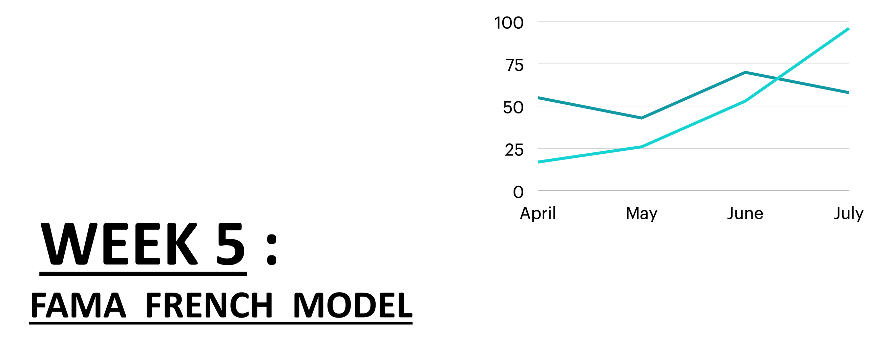

Slide 23
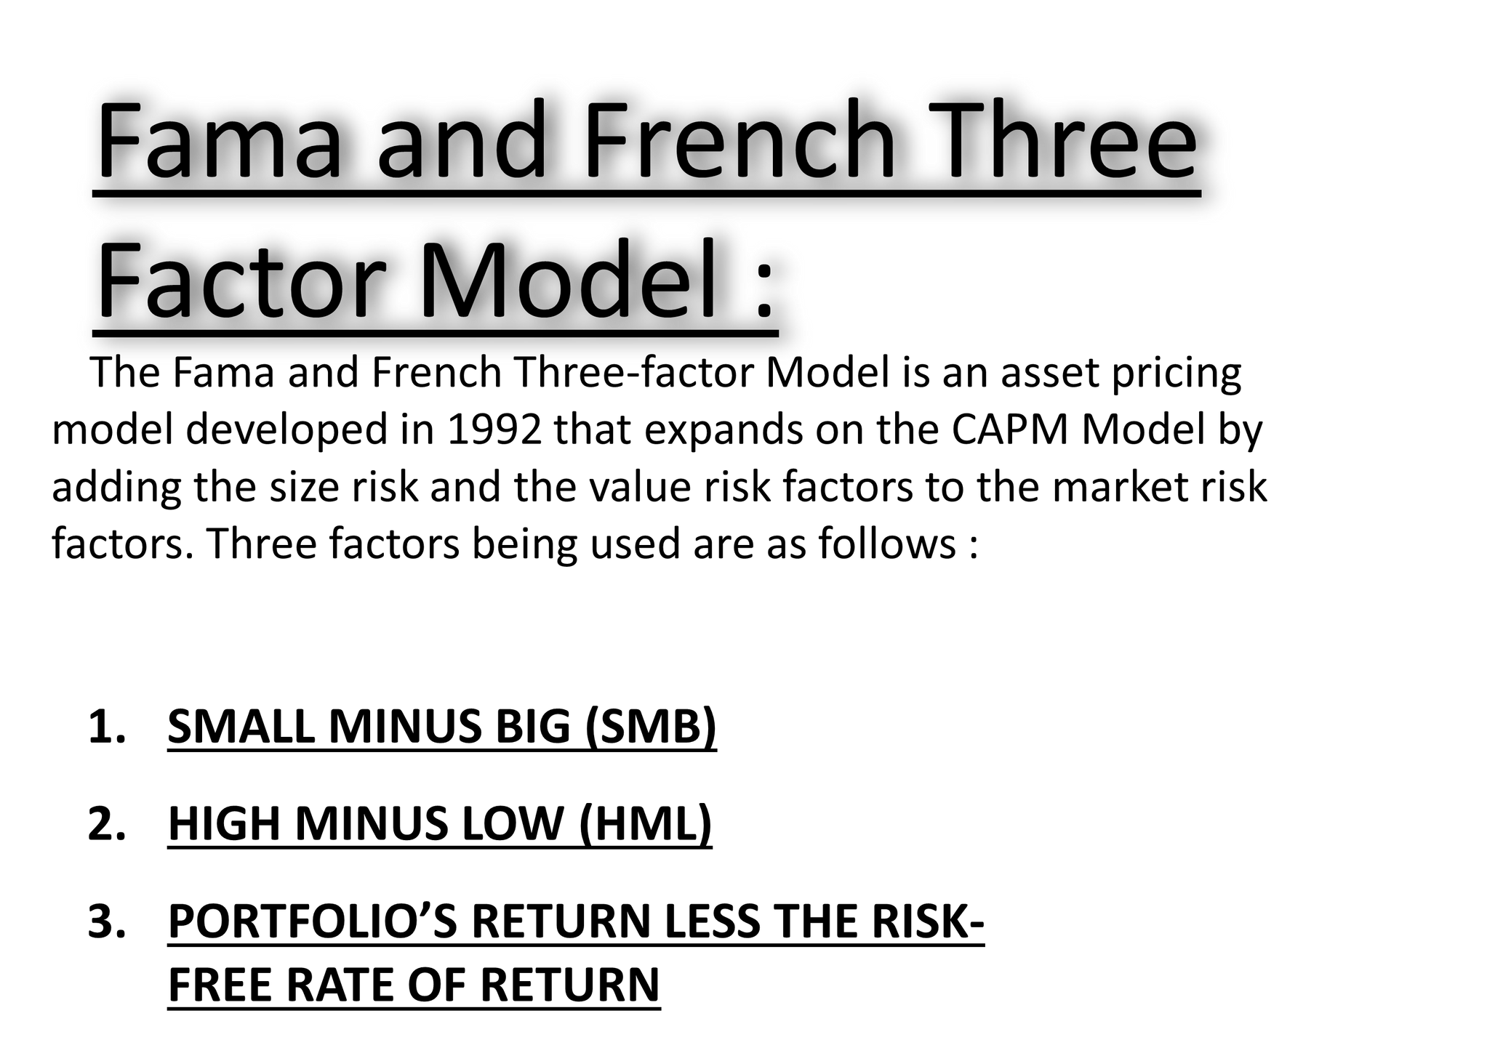

Slide 24
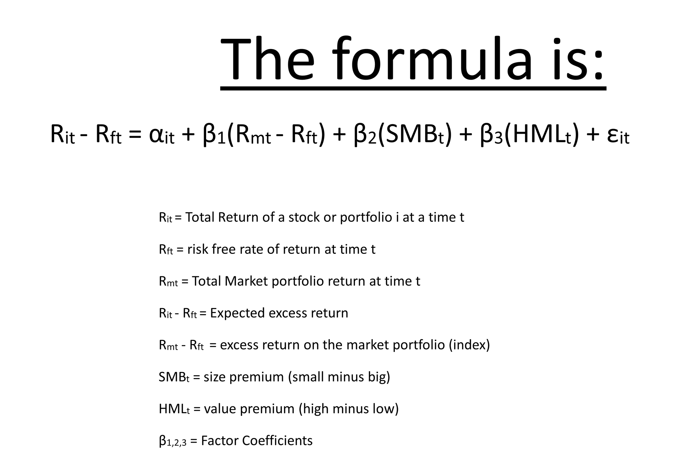

Slide 25
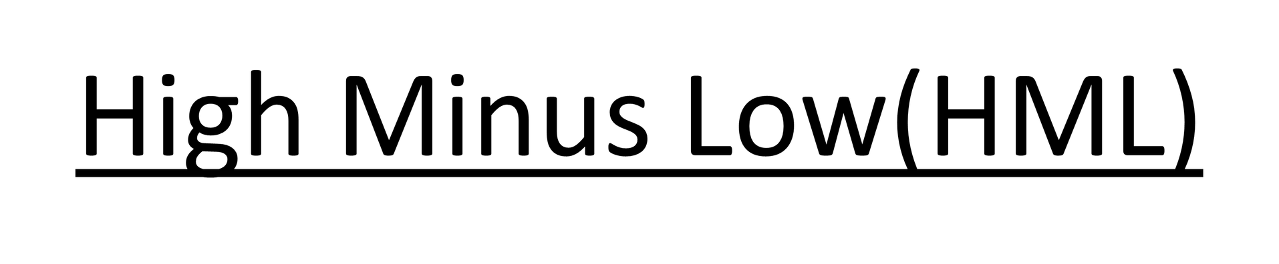
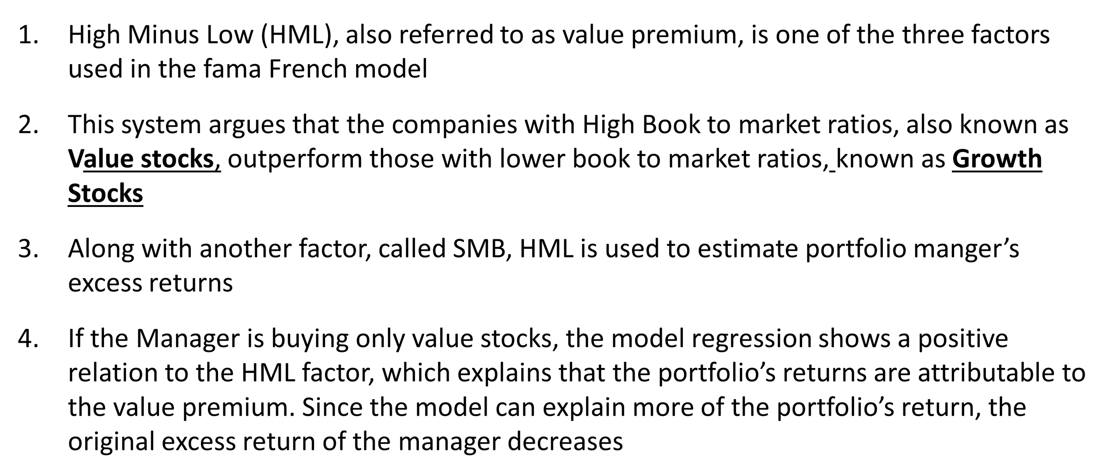

Slide 26
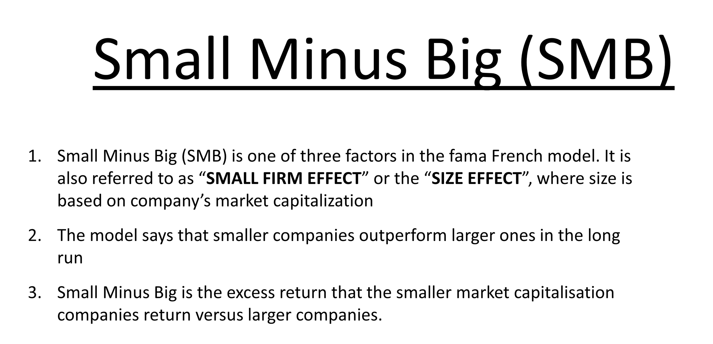

Slide 27
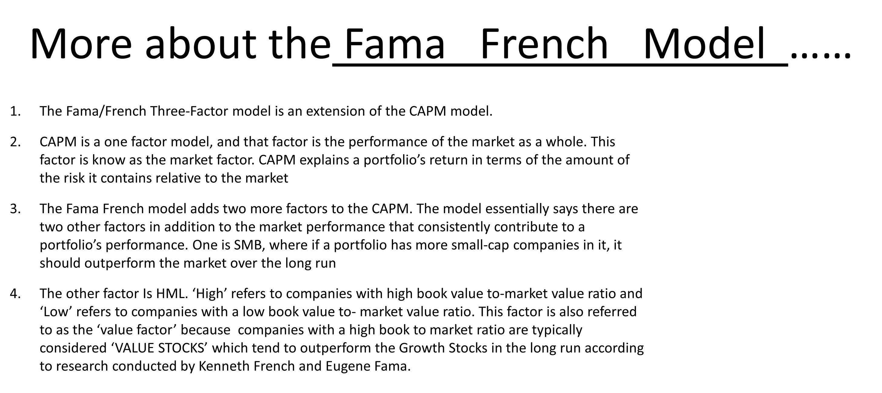

Slide 28
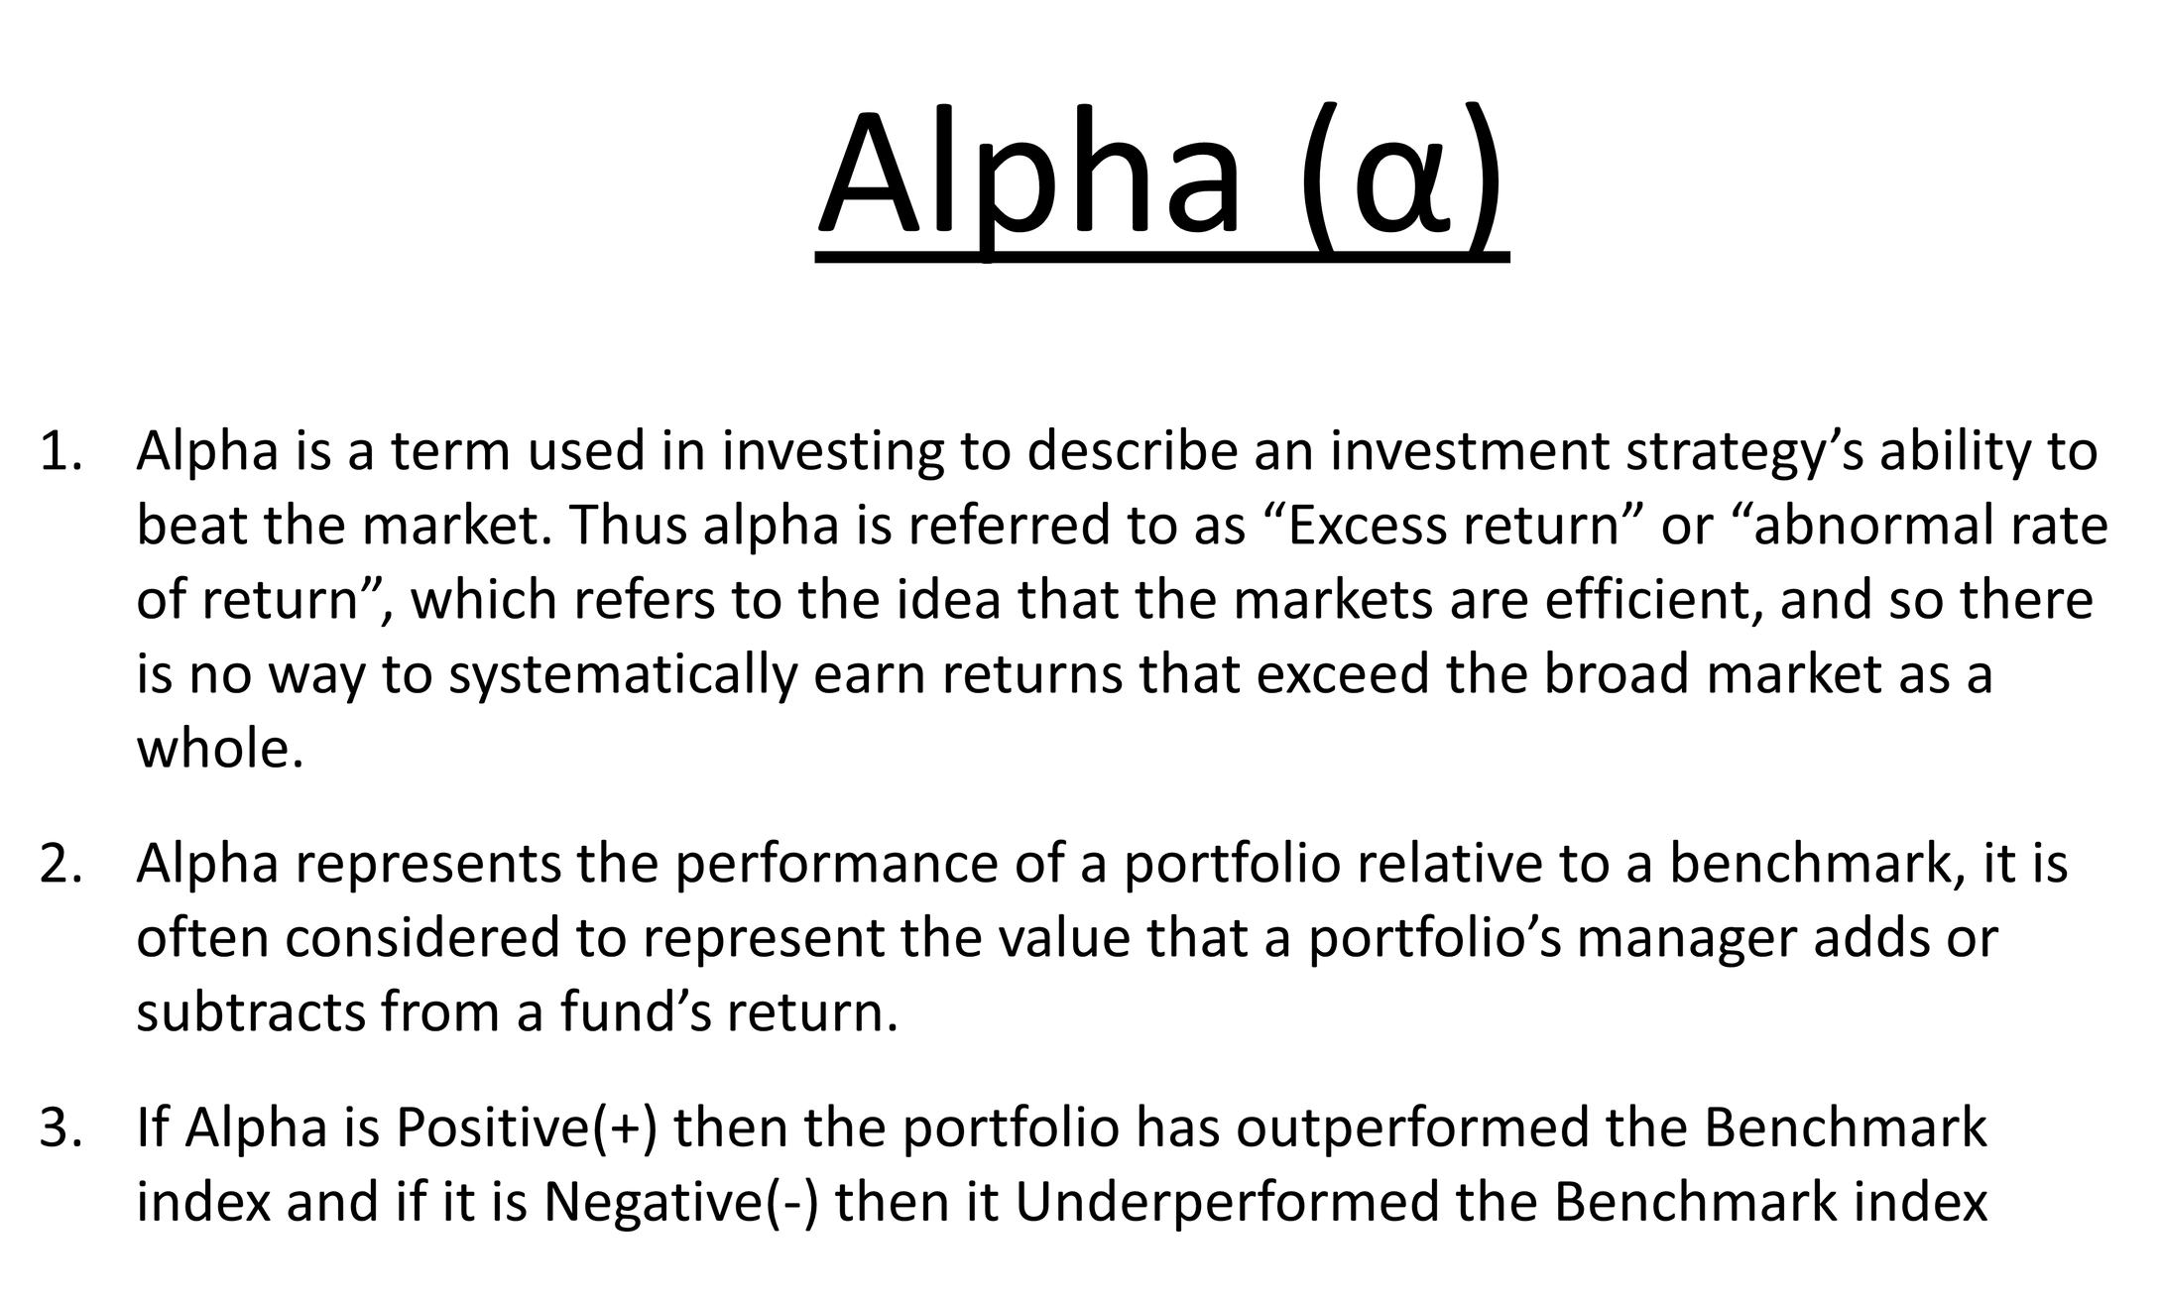

Slide 29
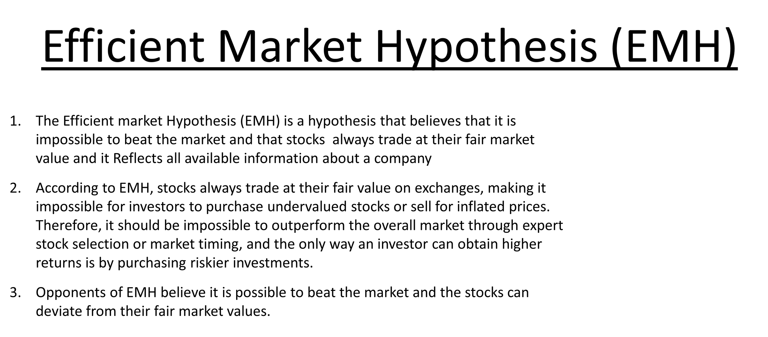

Slide 30
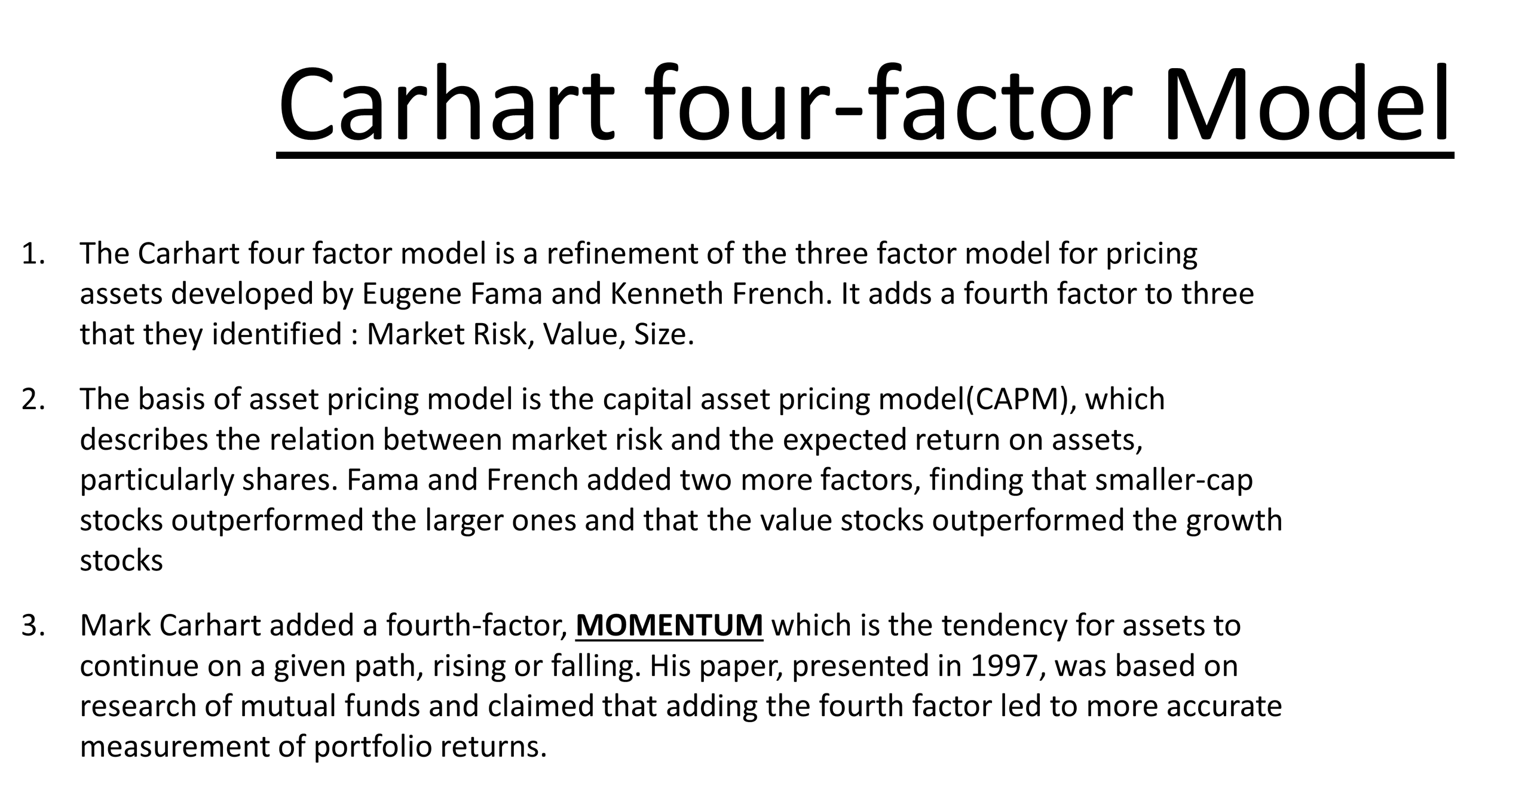

Slide 31
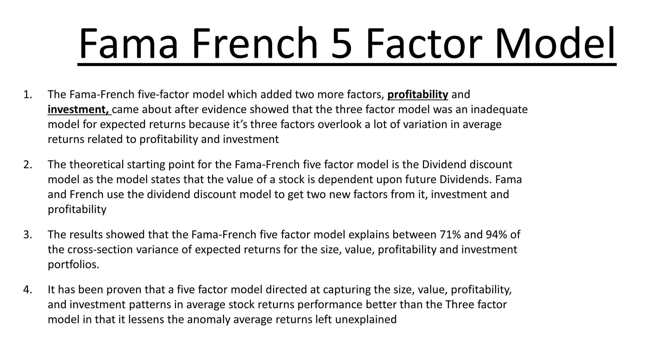

Slide 32
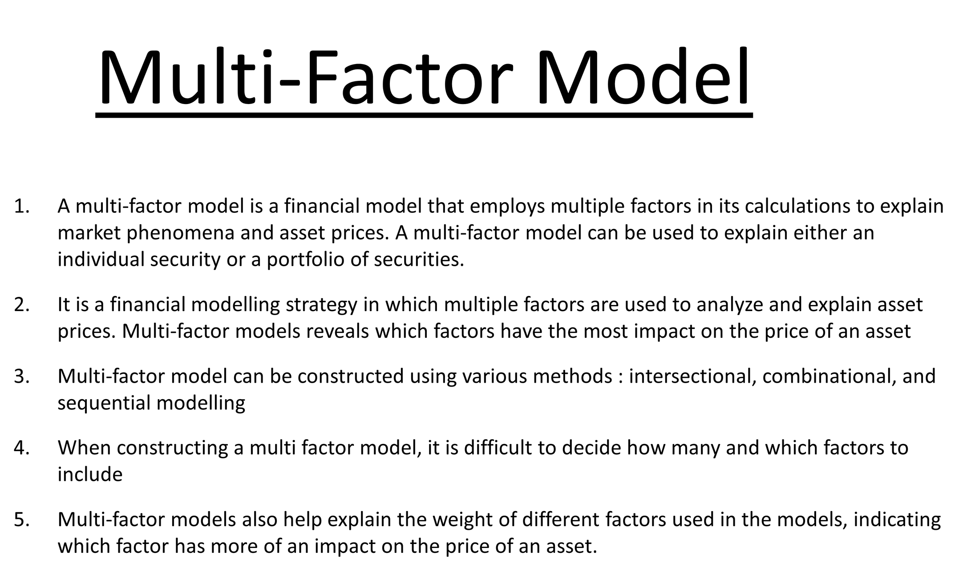

Slide 33
Week 6:Implementing Fama French Model Using Python and Finding Error

Slide 34
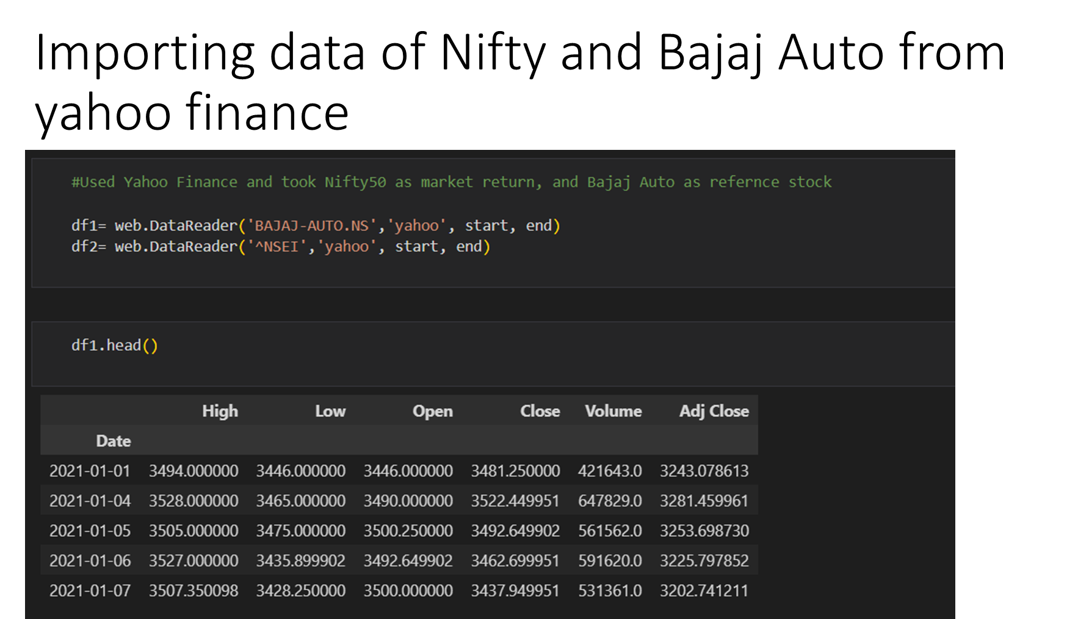

Slide 35
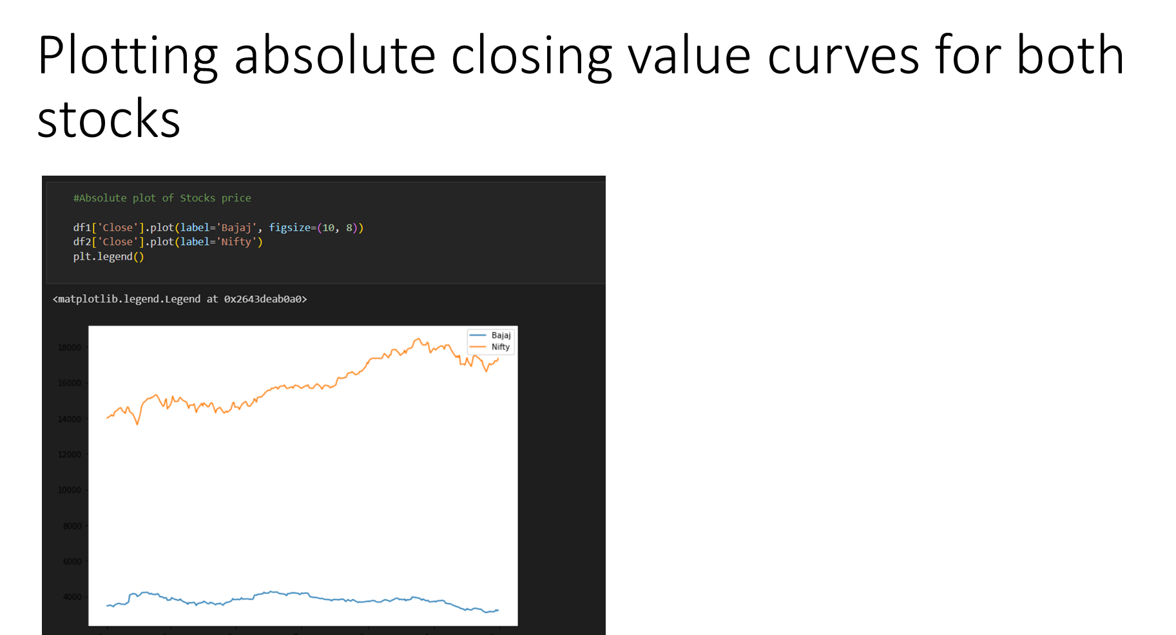

Slide 36
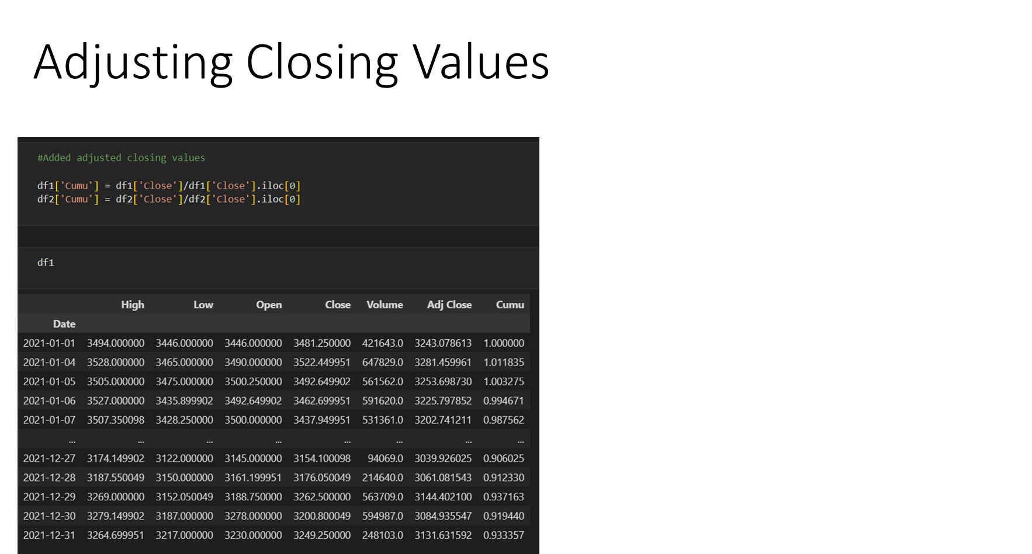

Slide 37
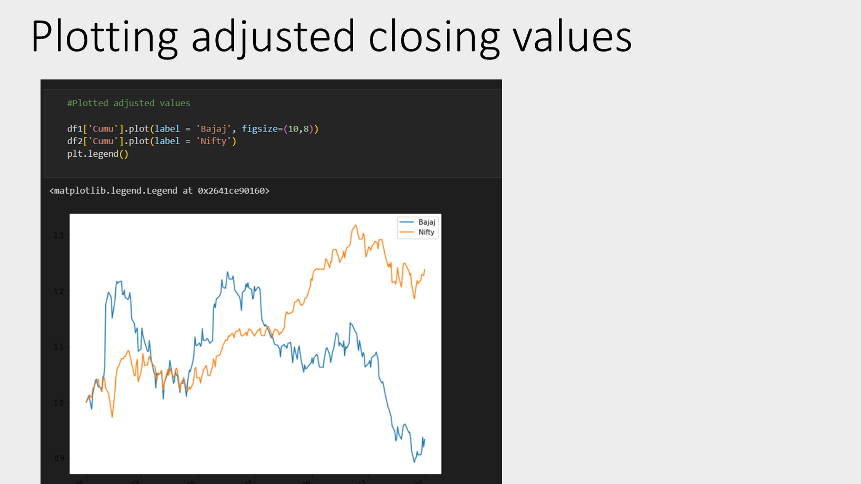

Slide 38
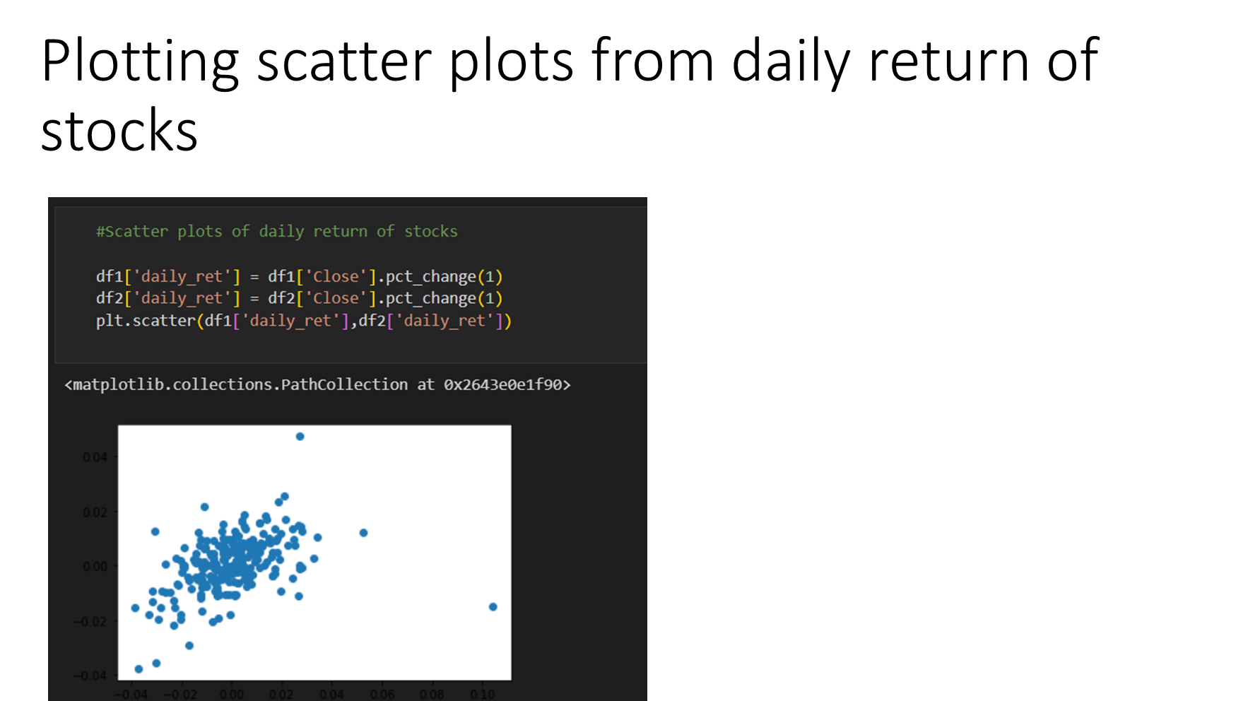

Slide 39
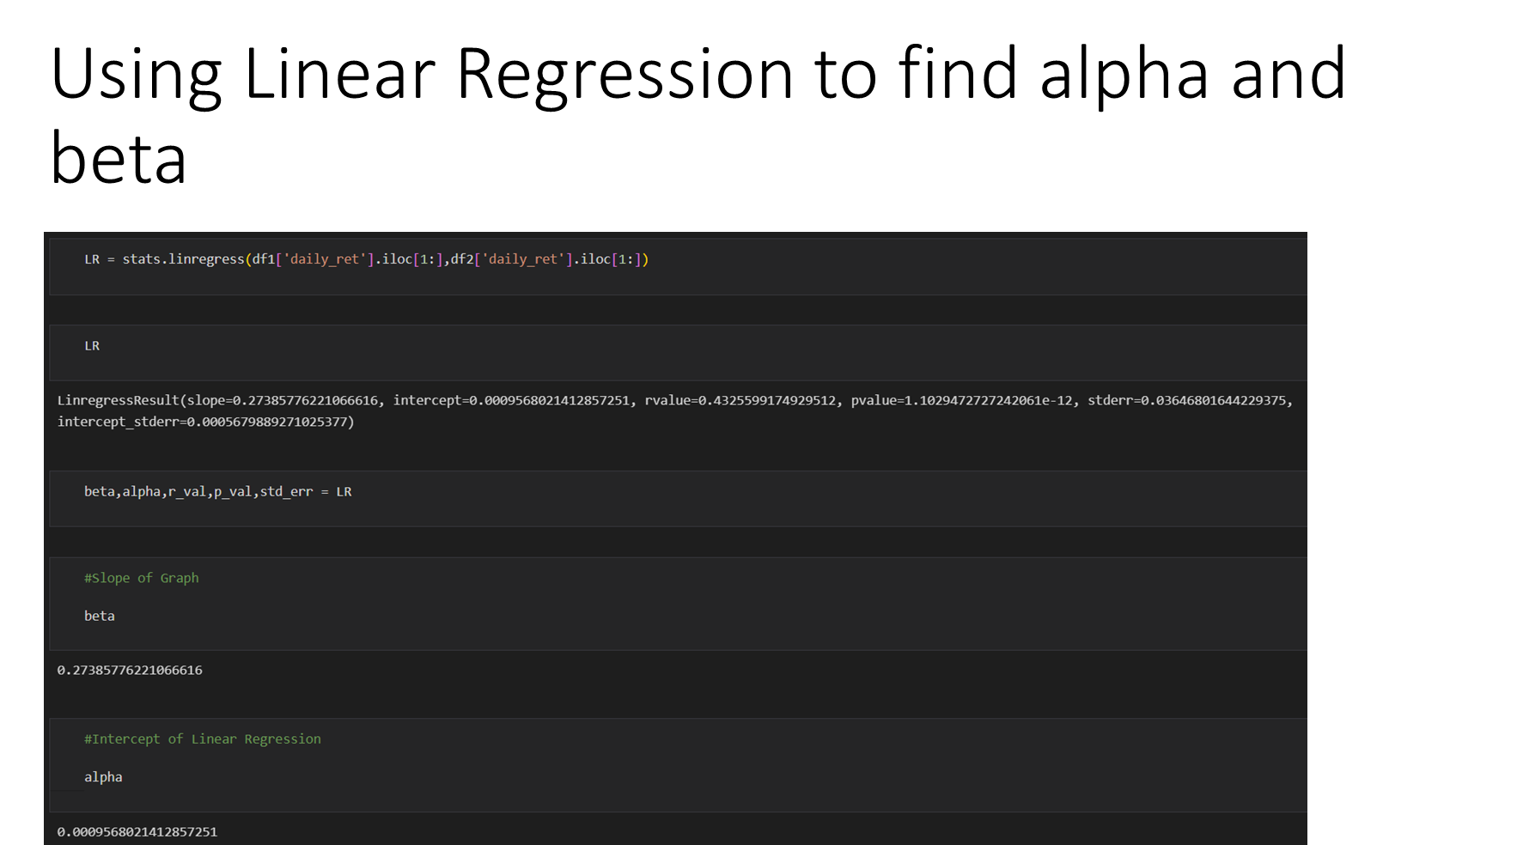

Slide 40
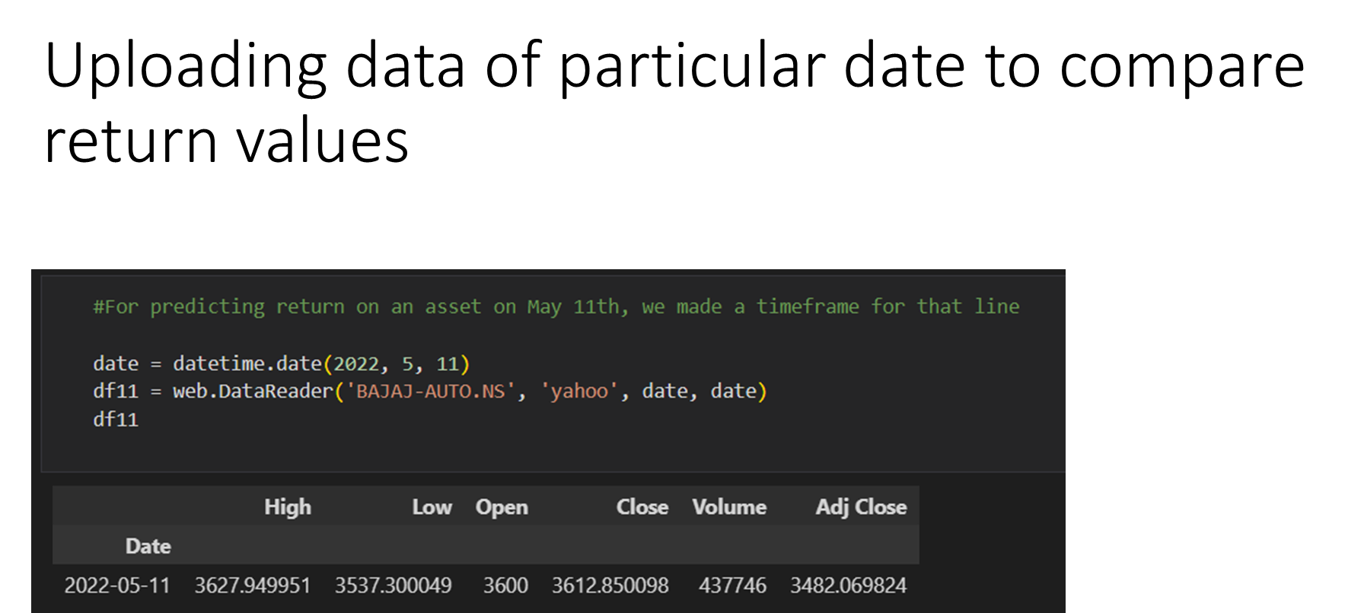

Slide 41
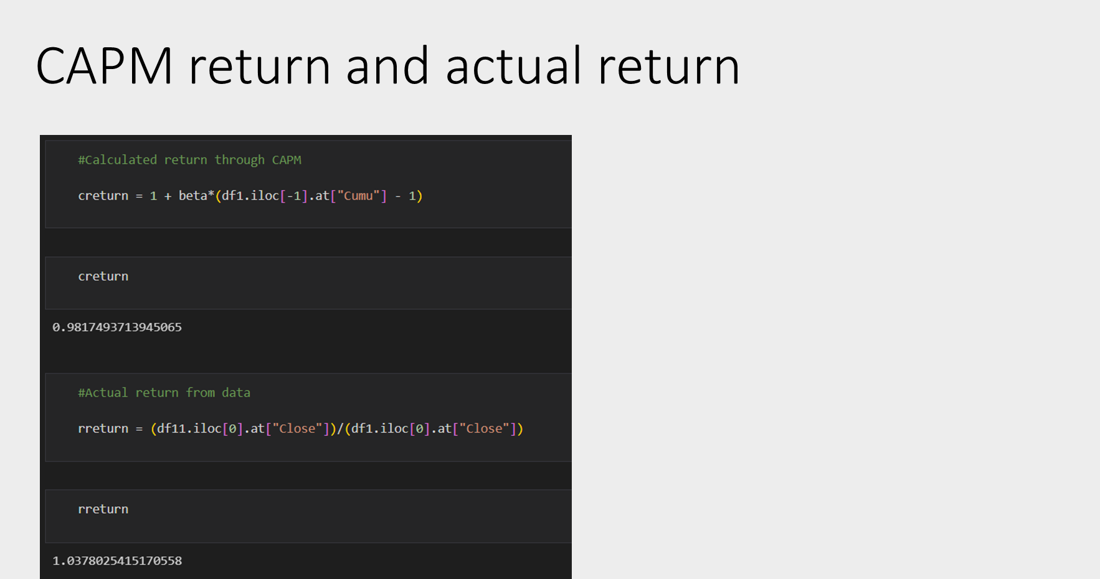

Slide 42
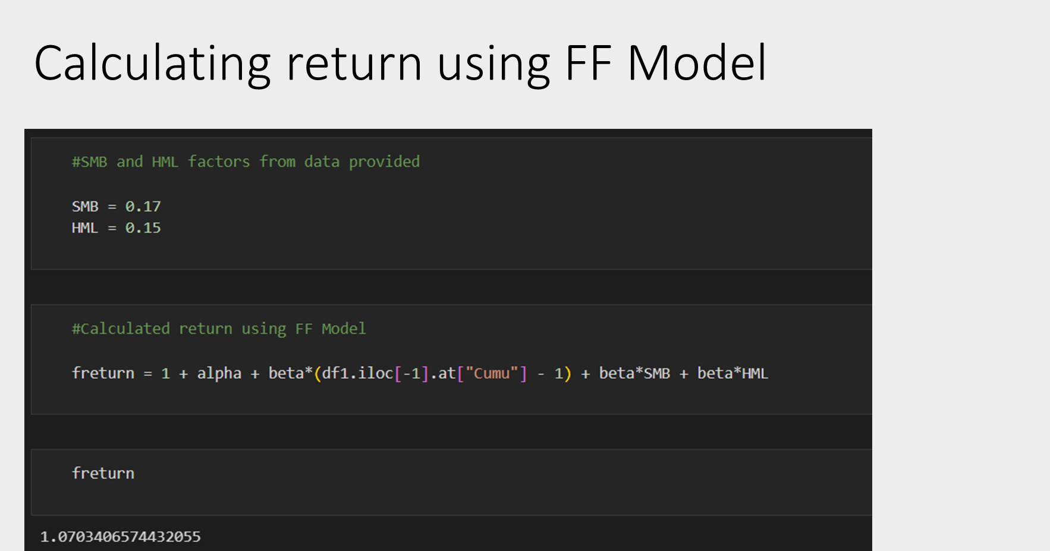

Slide 43
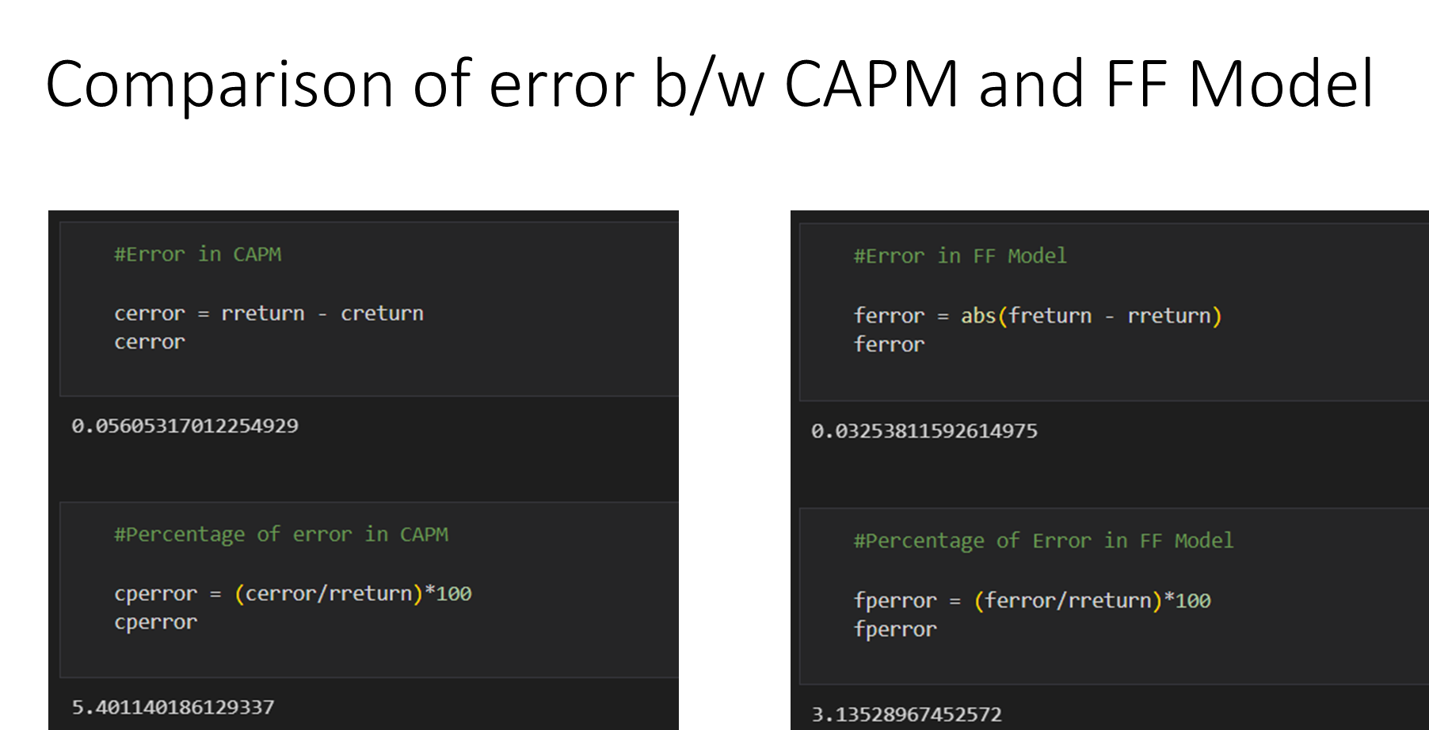

Slide 44
Thank you!

